Slide 1

IT Infrastructure Management Introduction TY B.Sc. (IT)
Semester VI
Poornima .N
Assistant Professor, Department of IT/CS
1

Slide 2

Contents of the Course:
2
Unit I: Introduction
Unit II: ITIL management practices
Unit III: Drive Stakeholder Value
Unit IV: Create, Delivery and Support
Unit V: High-Velocity IT
Syllabus of GIS

Slide 3

3 Topics:
IT service management in the modern world
About ITIL 4
The structure and benefits of the ITIL 4 framework.

Slide 4
4 IT Service Management in the Modern World
IT Service Management (ITSM) is how organizations manage their IT services to make sure they work well for users.
ITSM makes sure these services deliver value, work reliably, and meet business goals.

Slide 5
5 About ITIL 4
ITIL = Information Technology Infrastructure Library
It’s a framework or guide that tells organizations how to deliver IT services effectively.
Not a software, not a tool — it’s best practices and guidelines.

Slide 6
6 Structure and Benefits of ITIL 4 Framework
It ensures that all activities in an organization work together to deliver value to customers through IT services.
Two Main Components of the ITIL 4 Framework:
1. ITIL Service Value System (SVS)
2. Four Dimensions Model

Slide 7
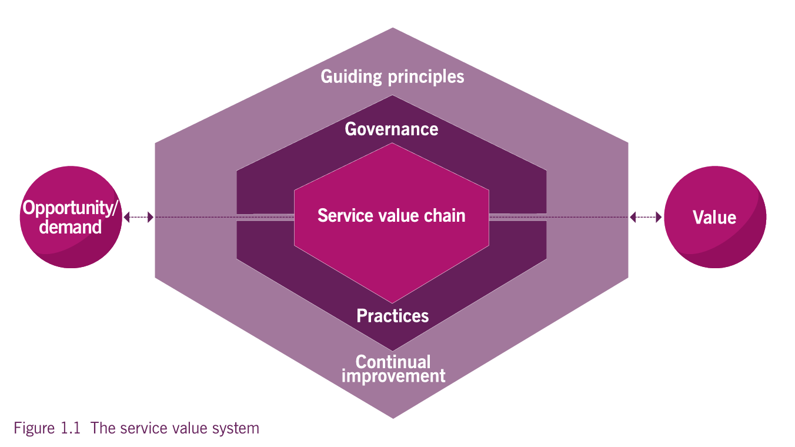
7 The Core Components of the ITIL SVS
It ensures that all activities in an organization work together to deliver value to

Slide 8
8 The Four Dimensions Model
Dimension | Meaning
1. Organizations and People | Roles, responsibilities, skills, and culture of the people involved in service management.
2. Information and Technology | The data, tools, and technology needed to deliver and manage services.
3. Partners and Suppliers | The external organizations, vendors, or suppliers that help deliver services.
4. Value Streams and Processes | The workflows and steps needed to deliver value efficiently.

Slide 9
9 Examples
ITSM is like running a restaurant. The kitchen (IT) has to deliver meals (services) to customers (users) on time and tasty. ITIL 4 is the recipe book that helps the kitchen work efficiently, make customers happy, and improve continuously.

Slide 10
10 Activity
Column A – Terms | Column B – Meaning
1. IT Service Management (ITSM) | a) A structured way to manage IT services to deliver value
2. ITIL | b) A framework of best practices for ITSM
3. Service Provider | c) Organization that offers IT services
4. Service Consumer | d) Person or group who uses the service
5. Value | e) The benefit received from using a service
6. Co-creation | f) When provider and consumer work together to create value
7. Service Relationship | g) The cooperation between provider and consumer
8. Four Dimensions | h) People, technology, partners, processes
9. Service Value System (SVS) | i) Model showing how all parts of ITIL work together
10. Guiding Principles | j) General recommendations for all organizations

Slide 11

Thank you…

